Slide 1
Digital Electronics

Slide 2
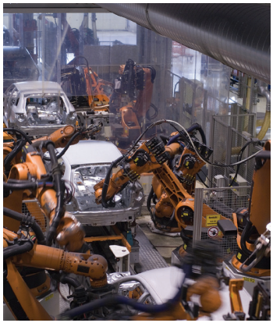
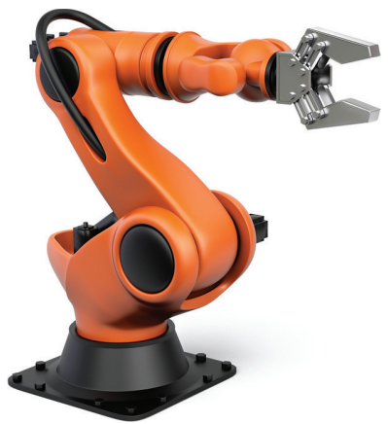
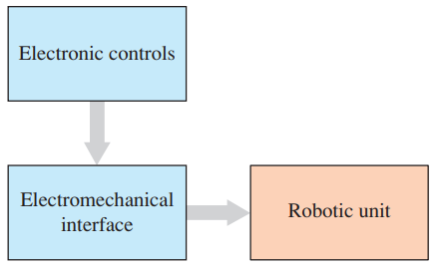
Mechatronics

Slide 3
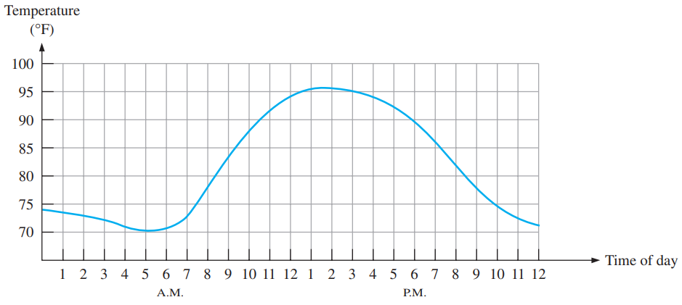
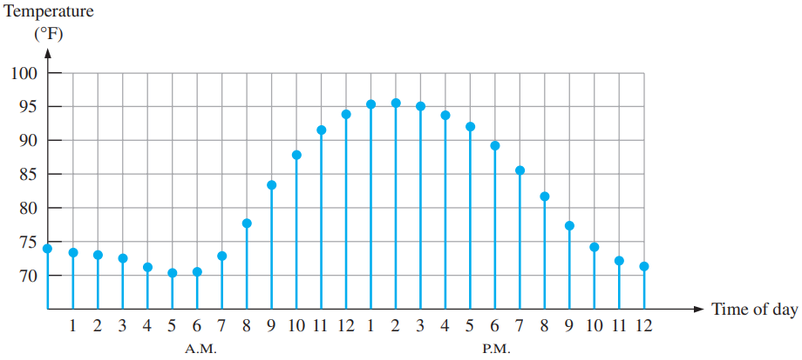
Digital and Analog Quantities

Slide 4
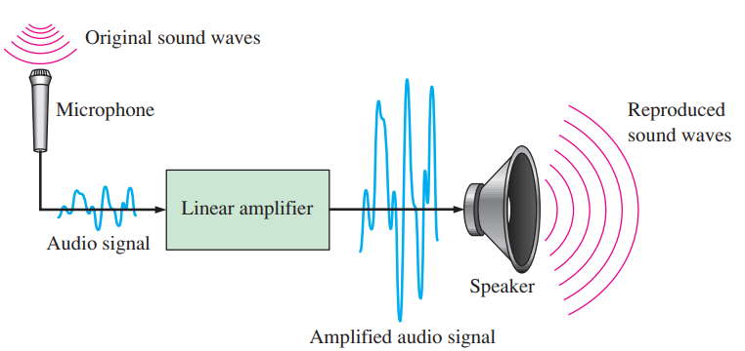
An Analog System

Slide 5
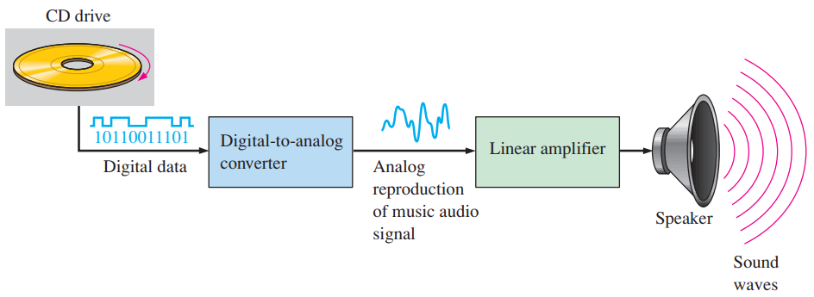
A System Using Digital and Analog Methods

Slide 6
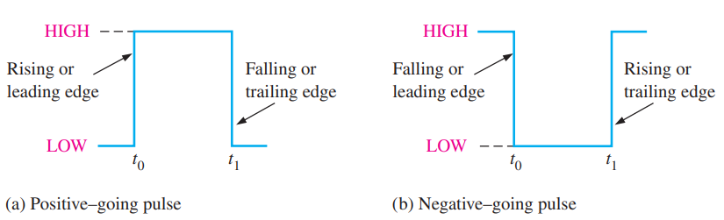
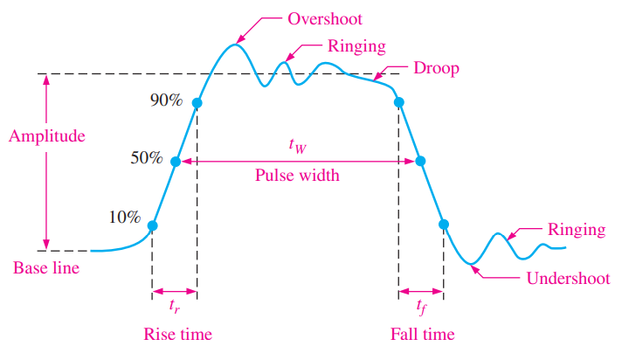
Basic Terminology
Binary Digits
Codes
Logic Levels
Digital Waveforms
Ideal Pulse
Nonideal pulse
Notes:
The overshoot and ringing are sometimes produced by stray inductive and capacitive effects.
The droop can be caused by stray capacitive and circuit resistance, forming an RC circuit with a low time constant.

Slide 7
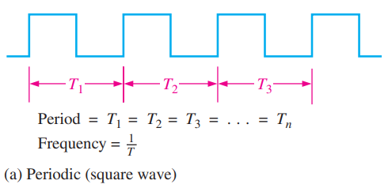

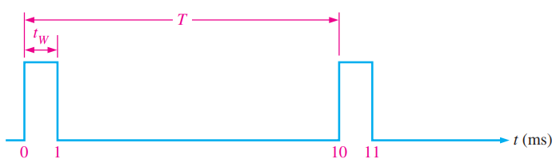
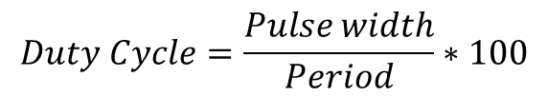
Waveform Characteristics
?Period
?Frequency
?Duty Cycle
$$Duty Cycle=\frac{Pulse width}{Period}∗100$$

Slide 8
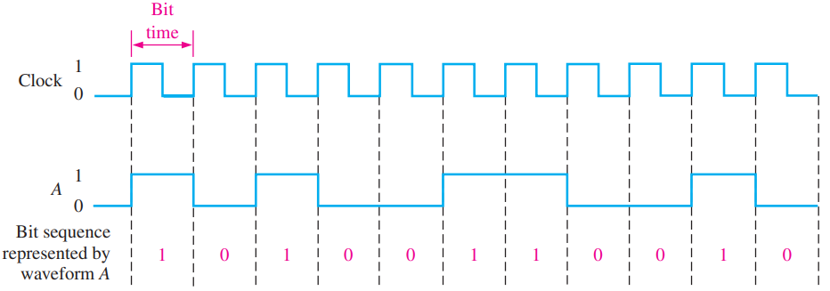
The Clock

Slide 9
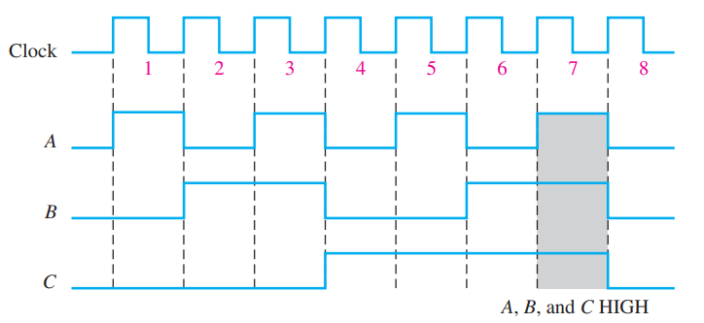
Timing Diagrams

Slide 10
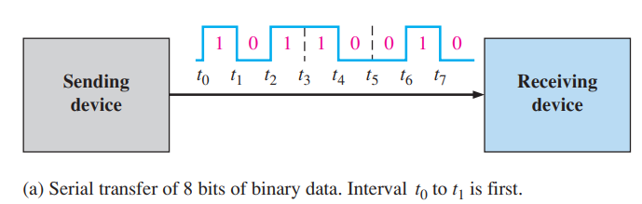
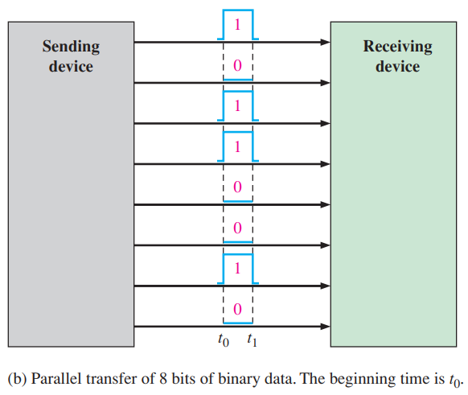
Data Transfer

Slide 11
Unit No. | Topics
1 | Number system, Logic gates, Boolean algebra, NAND and NOR implementation of logic functions. Determination of Boolean functions from Digital Circuits.
2 | Standard Representations of Logical Functions, SOP and POS form, Simplification of Logical functions using K-map.
3 | Combinational Logic Circuit: Adder, Subtractor, Magnitude Comparator, Code converters etc. MSI Circuits: Multiplexers, Demultiplexers, Decoders, Encoders etc.
4 | Sequential circuits: Latches and Flip-flops, Counters, Shift registers.
5 | Analysis of sequential circuits: State tables and state diagrams. Timing circuits.
6 | Introduction to logic families. Semiconductor memories, ROM, PAL, PLA and Microprocessor.

Slide 12
Textbook
Digital Logic and Computer Design by M. Morris Mano, Prentice-Hall, 2015.
Floyd T. L., Digital Fundamentals, 10th Edition, Pearson Education, 2011.
Reference Books
Fundamental of Digital Electronics by A. Anand Kumar, 4th Edition, Prentice Hall, 2016.
Digital Principles and Applications by Malvino & Leach, 8th Edition, McGraw Hill, 2014.
Modern Digital Electronics by R. P. Jain, 4th Edition, McGraw Hill, 2009.
Digital Integrated Electronics by Paul & Schilling, McGraw Hill, 2008.
The evaluation scheme is as follows:
End Semester Examination: 50 marks
Mid Semester Examination: 30 marks
Quizzes: 2 quizzes of 10 marks each

Slide 14
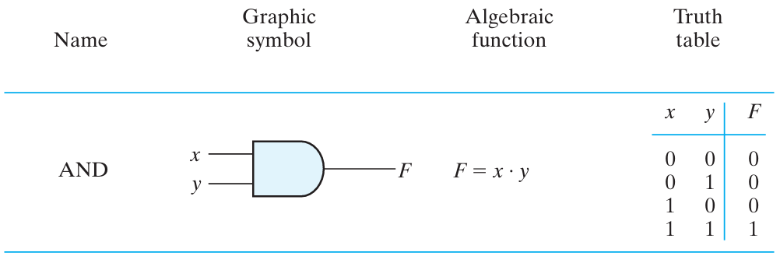
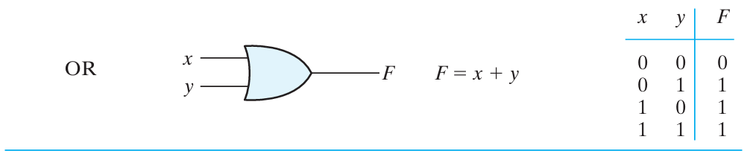
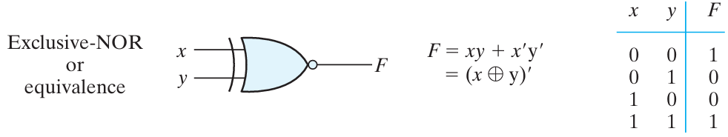
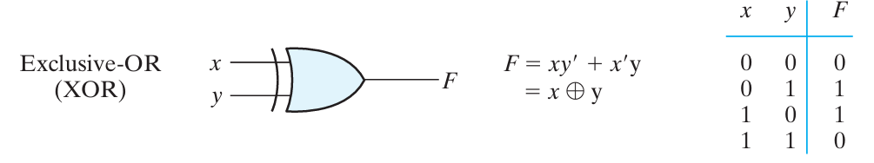
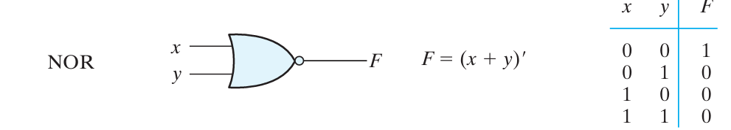
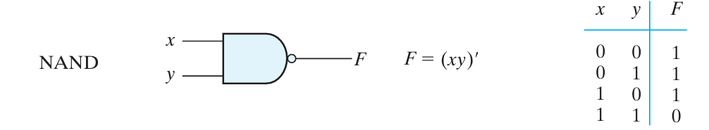
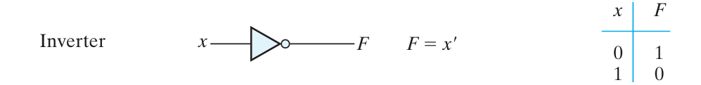
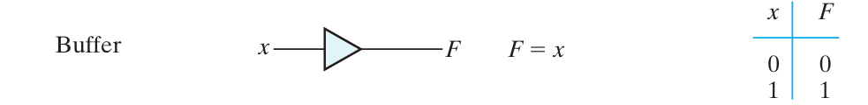

Slide 15
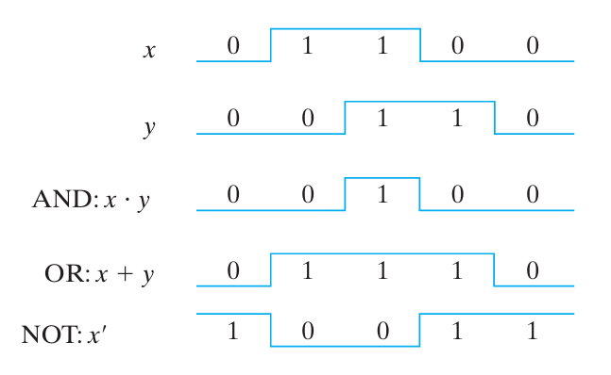
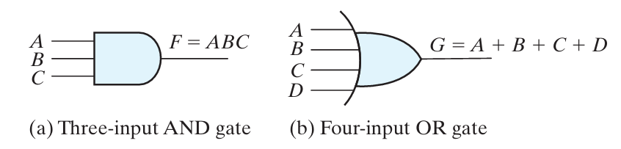

Slide 16
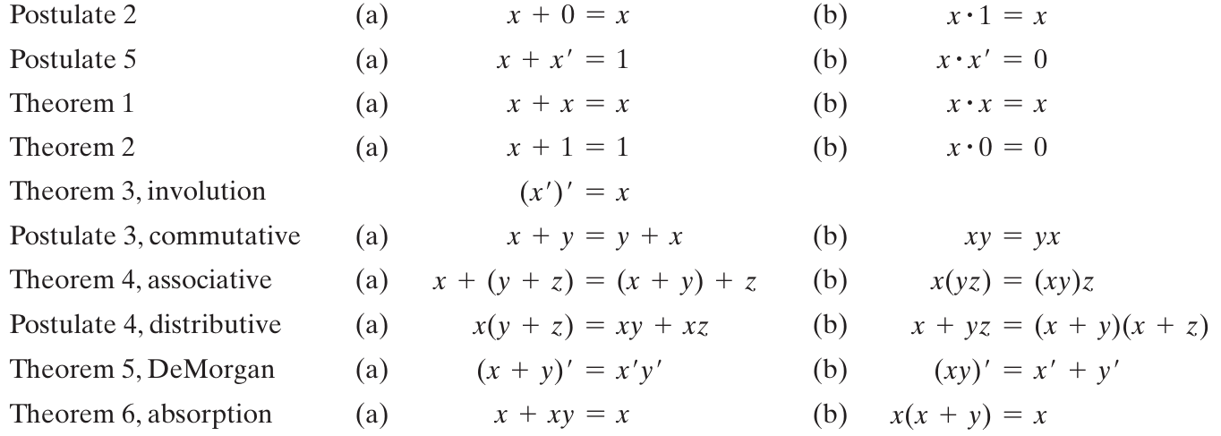
Postulates and Theorems of Boolean Algebra

Slide 17
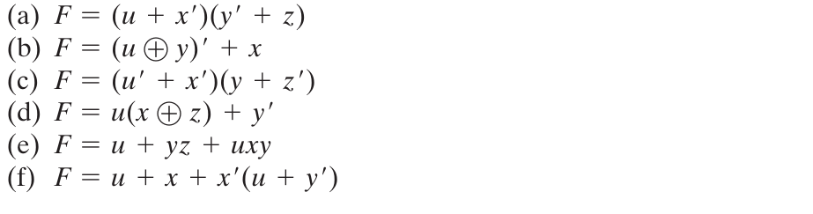
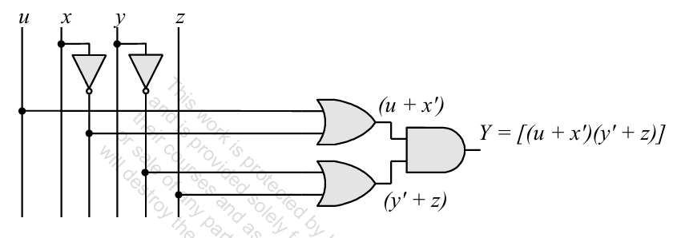
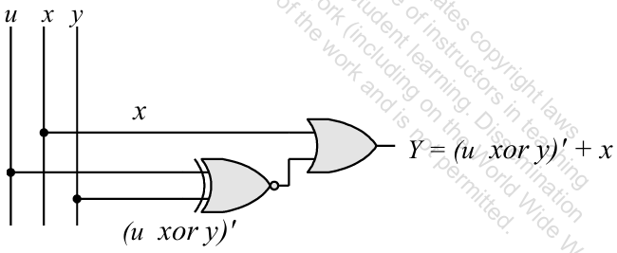
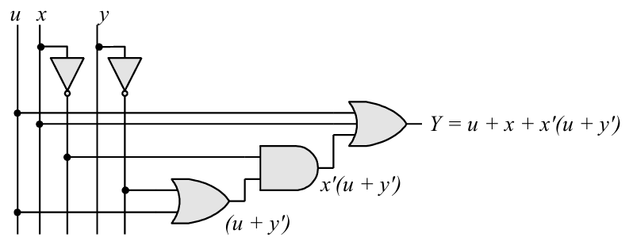
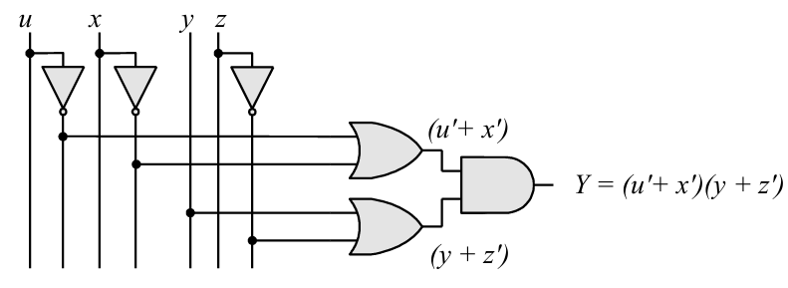
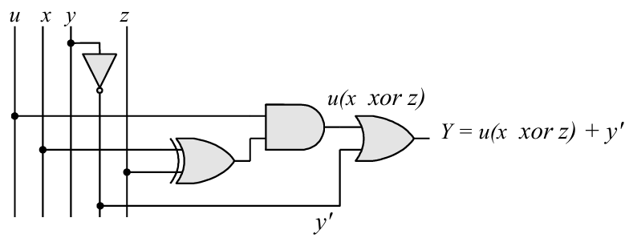
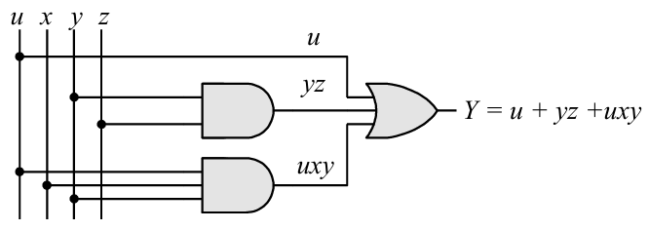
Draw logic diagrams to implement the following Boolean expression

Slide 18
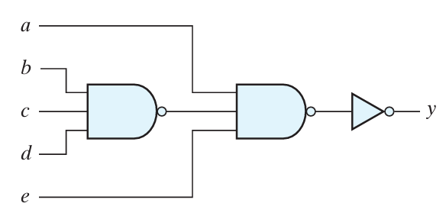

Write Boolean Expression

Slide 19
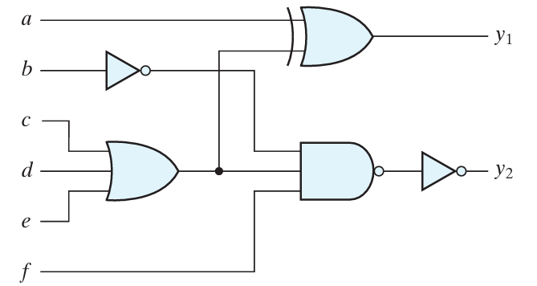


Write Boolean Expression

Slide 20
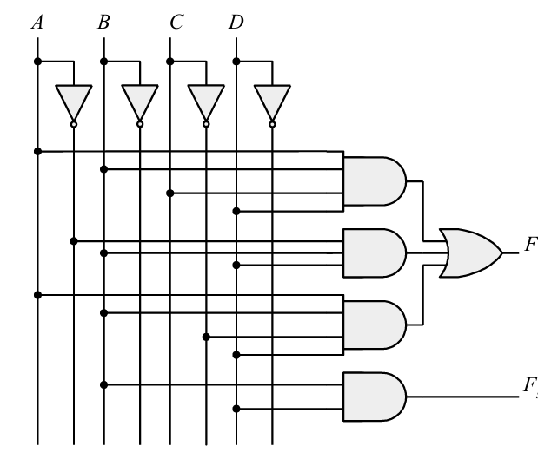
Write Boolean Expression

Slide 21
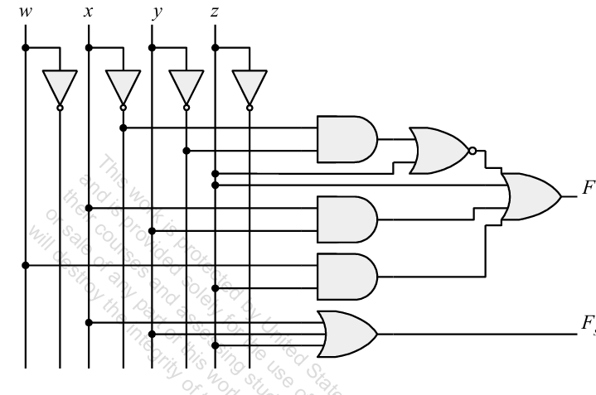
Write Boolean Expression

Slide 22
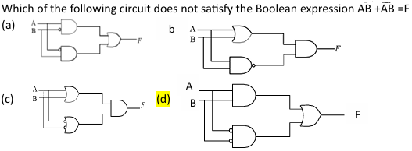
a
b
c
d

Slide 23

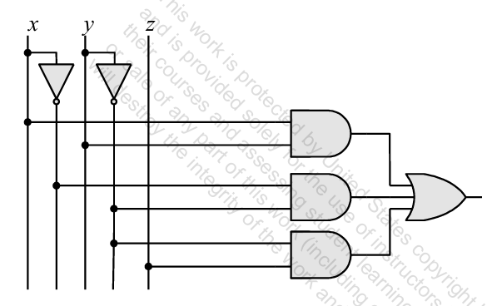
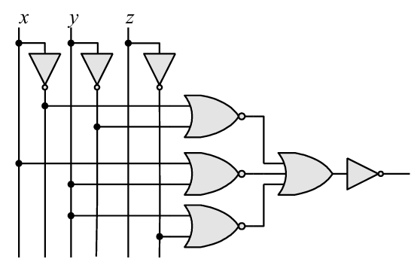
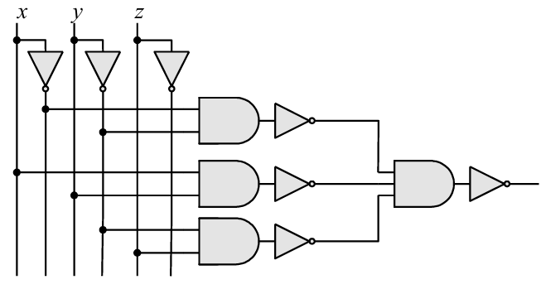
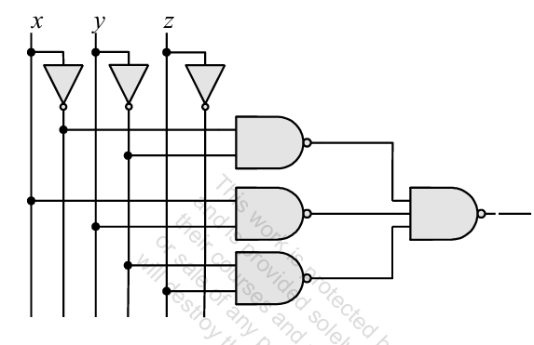
a
b
c
d

Slide 24
Find the complement of the expression: x′y+(x+z)(x+y′)
Find the dual of the expression: x′y+(x+z)(x+y′)

Slide 25
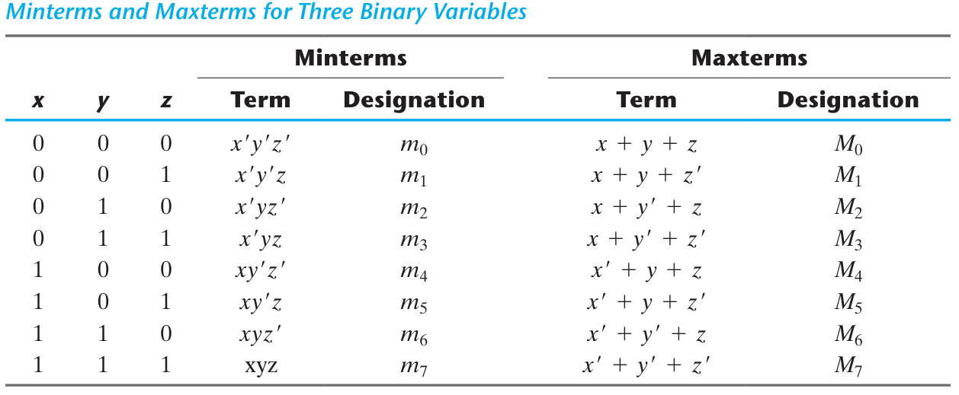
Minterms and Maxterms

Slide 26
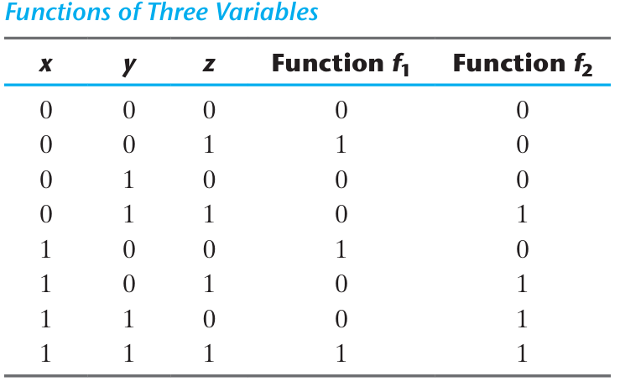



Minterms and Maxterms
A Boolean function can be expressed algebraically from a given truth table by forming a minterm for each combination of the variables that produces a 1 in the function and then taking the OR of all those terms.
Any Boolean function can be expressed as a sum of minterms

Slide 27

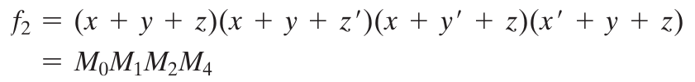
Minterms and Maxterms
Any Boolean function can be expressed as a product of maxterms.
Boolean functions expressed as a sum of minterms or product of maxterms are said to be in canonical form.

Slide 28

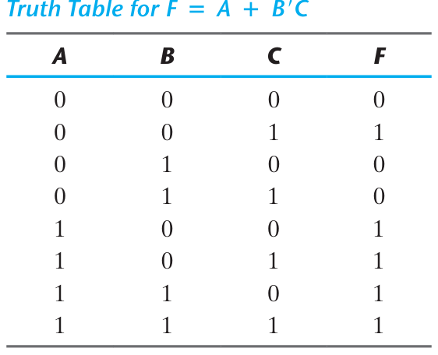


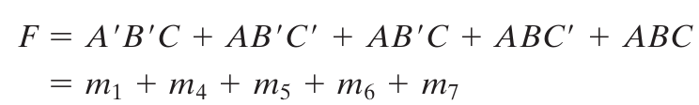

Express the Boolean function F = A + B′C as a sum of minterms.

Slide 29





Express the Boolean function F = xy + x′z as a product of maxterms.

Slide 30


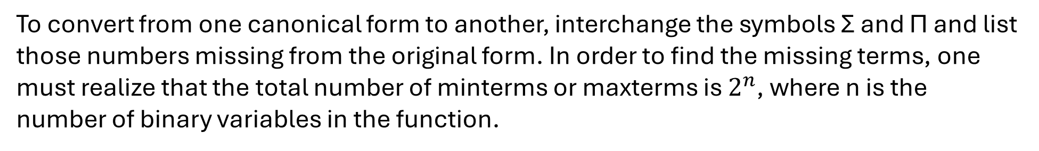
Conversion between Canonical Forms
That is, the maxterm with subscript j is a complement of the minterm with the same subscript j and vice versa.
To convert from one canonical form to another, interchange the symbols Σ and Π and list those numbers missing from the original form. In order to find the missing terms, one must realize that the total number of minterms or maxterms is $2^{n}$, where n is the number of binary variables in the function.

Slide 31
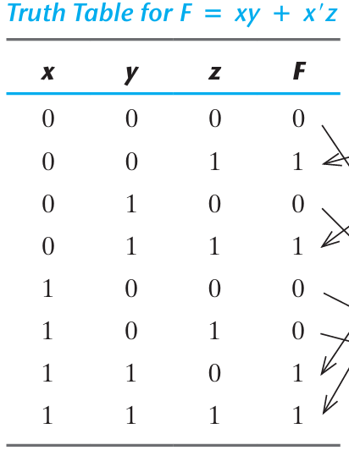



F = xy + x′z

Slide 32




Standard Forms
Sum of products.
Product of Sums.

Slide 33




Slide 34


Slide 35





Slide 36



Slide 37



Slide 38
Karnaugh map or K-map method
A K-map is a diagram made up of squares, with each square representing one minterm of the function that is to be minimized.
Boolean function can be expressed as a sum of minterms.
The map presents a visual diagram of all possible ways a function may be expressed in standard forms (sum of products or product of sums).
Simplest algebraic expression is one that has a minimum number of terms with the smallest possible number of literals in each term.

Slide 39


Slide 40


NAND AND NOR IMPLEMENTATION
NAND Circuits

Slide 41




Two-Level Implementation

Slide 42



Multilevel NAND Circuits

Slide 43



Multilevel NAND Circuits

Slide 44


NOR Implementation

Slide 45




NOR Implementation

Slide 46



Slide 47





Slide 48


Slide 49







$$T_{2}$$
$$T_{1}$$
$$T_{3}$$
$$F_{2}^{′}$$

Slide 50
Combinational Circuit
Adder
Subtractor
Multiplier
Comparator
Decoder
Encoder
Multiplexer

Slide 51

Comparator

Slide 52


State Reduction
Reducing the number of states in a state table, while keeping the external input–output requirements unchanged.
The states themselves are of secondary importance, because we are interested only in output sequences caused by input sequences.

Slide 53




“Two states are said to be equivalent if, for each member of the set of inputs, they give exactly the same output and send the circuit either to the same state or to an equivalent state.”

Slide 54


Slide 55


State Assignment

Slide 56
Designing synchronous sequential circuits
From the word description and specifications of the desired operation, derive a state diagram for the circuit.
Reduce the number of states if necessary.
Assign binary values to the states.
Obtain the binary-coded state table.
Choose the type of flip-flops to be used.
Derive the simplified flip-flop input equations and output equations.
Draw the logic diagram.

Slide 57




Slide 58






Logic diagram of a sequence detector

Slide 59



Excitation Tables

Slide 60




Synthesis Using JK Flip-Flops

Slide 61


Slide 62
Synthesis Using T Flip-Flops
Binary Counter

Slide 63


Slide 64

Registers and Counters
A register is a collection of flip-flops used to store binary data.
Each flip-flop stores 1 bit of information.
All flip-flops share a common clock signal.
An n-bit register consists of n flip-flops → stores n bits
A counter is a special type of register.
It goes through a predefined sequence of binary states
Each state represents a count value
Up counter, Down counter, Up/Down counter

Slide 65

Register Includes flip flop and combinational logic gates:
Flip-flops → store data
Combinational logic gates → control data flow
Flip-flops hold binary information
Logic gates determine how data is loaded, transferred, or modified.
Load = 1: New data is loaded on the next clock edge
Load = 0: Register holds its current value
Four-bit register with parallel load

Slide 66

Four-bit shift register
…000111
0 | 1 | 0 | 1
…00011
1
1 | 0 | 1 | 0
…0001
01
1 | 1 | 0 | 1

Slide 67



Serial Transfer
Data is processed one bit at a time using shift operations.

Slide 68


Serial Addition

Slide 69


Serial Addition

Slide 70

Serial Addition

Slide 71

Universal Shift Register
Serial in → Parallel out: Data shifted in serially can be read simultaneously from flip-flop outputs.
Parallel in → Serial out: Data loaded in parallel can be shifted out one bit at a time.
Parallel input and Parallel output.
Shift data both right and left.
Clear control: Reset register to 0
Clock input: Synchronizes operations
Shift-right control: Enables right shift + serial I/O
Shift-left control: Enables left shift + serial I/O
Parallel-load control: Enables parallel data input (n lines)
Parallel outputs: n output lines available
Hold state: Retains data (no change on clock)
Unidirectional shift register
Bidirectional shift register
Universal shift register

Slide 72



Slide 80
Counters
A counter is a register that goes through a fixed sequence of states.
Triggered by input pulses (clock or external signals)
Sequence can be:
Binary or Any custom-defined sequence
Binary Counter
Follows binary number sequence
An n-bit counter → n flip-flops
Counts from 0 to (2ⁿ − 1)
Ripple (Asynchronous) Counter
Flip-flops are triggered by outputs of other flip-flops
No common clock for all stages
Simple but slower (propagation delay)
Synchronous Counter
All flip-flops share a common clock
Operate simultaneously
Faster and more reliable

Slide 81




UP Counter
Down Counter

Slide 82


BCD Ripple Counter

Slide 83


Slide 84

Synchronous Counters

Slide 85

Four-bit up–down binary counter

Slide 86


BCD Counter

Slide 87





Counter with Unused States
Self-correcting Counter

Slide 88



Ring Counter
$$A_{0}$$ | $$A_{1}$$ | $$A_{2}$$ | $$A_{3}$$
1 | 0 | 0 | 0
0 | 1 | 0 | 0
0 | 0 | 1 | 0
0 | 0 | 0 | 1
1 | 0 | 0 | 0
0 | 1 | 0 | 0
0 | 0 | 1 | 0
0 | 0 | 0 | 1
1 | 0 | 0 | 0
A ring counter is a circular shift register with only one flip-flop being set at any particular time; all others are cleared.

Slide 89


Generation of timing signals
Example: 16 timing signals
16-bit shift register connected as a ring counter
Or
4-bit binary counter and a 4-to-16-line decoder
$2^{n} timing signals$: shift register with $2^{n}$ flipflops or an $n$-bit binary counter together with an ${n−to− 2}^{n}$line decoder

Slide 90




Johnson Counter
$$A_{0}$$ | $$A_{1}$$ | $$A_{2}$$ | $$A_{3}$$
0 | 0 | 0 | 0
1 | 0 | 0 | 0
1 | 1 | 0 | 0
1 | 1 | 1 | 0
1 | 1 | 1 | 1
0 | 1 | 1 | 1
0 | 0 | 1 | 1
0 | 0 | 0 | 1
0 | 0 | 0 | 0
1 | 0 | 0 | 0
Number of flip-flops is less than that in a ring counter, and the decoder requires only two-input gates

